Slide 1




IOT ENABLED ULTRASONIC OBJECT DETECTION AND RANGING SYSTEM USING ARDUINO
2303811710622003 ABITHA K R
2303811710622008 AKALYA B
23038111710622026 GAYATHRI K K
Guided by:
Mr.MANI.P
Assistant professor (ECE)

Slide 2
PROBLEM STATEMENT
Manual methods of object detection are time-consuming and less accurate.
Traditional sensors cover only a limited area and cannot scan multiple directions effectively.
There is a need for a low-cost, simple, and efficient radar system that can detect objects and measure their distance automatically.
The system should be able to scan an area by rotating the sensor and identify the direction and distance of nearby obstacles.

Slide 3


OBJECTIVE
To design a radar system that can detect objects using an ultrasonic sensor mounted on a servo motor.
To measure the distance and direction of objects around the sensor.
To visualize the detected objects on a radar-like interface (using software such as Processing IDE).
To provide a simple and cost-effective model for understanding radar principles using Arduino.

Slide 4
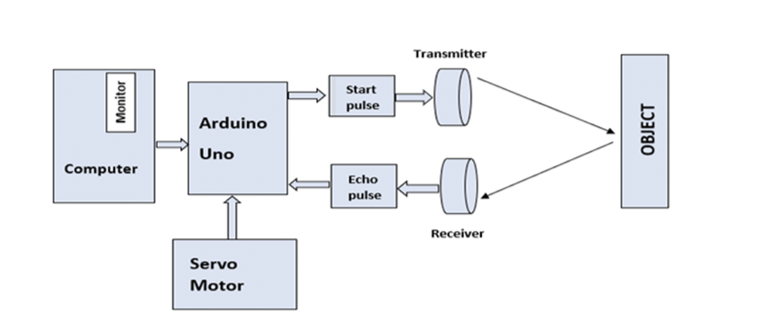
BLOCK DIAGRAM

Slide 5
BLOCK DIAGRAM EXPLANATION
Power Supply gives 5V power to Arduino, sensor, and servo motor.
Arduino UNO controls the sensor and motor, and processes all signals.
Ultrasonic Sensor detects the distance of objects by sending and receiving sound waves.
Servo Motor rotates the sensor, and the detected data is shown on the display as a radar view.

Slide 6
HARDWARE MODULE
Arduino UNO – The main microcontroller that processes sensor data and controls the servo motor rotation.
Ultrasonic Sensor (HC-SR04) – Used to measure the distance to nearby objects by sending and receiving ultrasonic pulses.
Servo Motor (SG90) – Rotates the ultrasonic sensor in a specific range (e.g., 0°–180°) to scan the surroundings.
Breadboard and Jumper Wires – Used to make necessary electrical connections.
Power Supply (5V/USB) – Powers the Arduino and components.
Processing IDE – For displaying radar visualization on a computer screen.

Slide 7
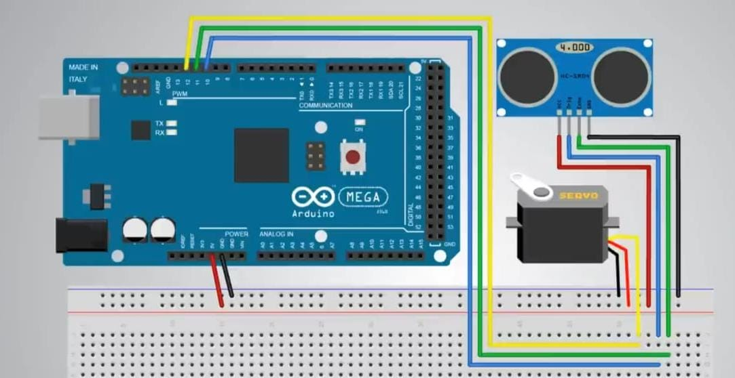
CIRCUIT DIAGRAM

Slide 8
CIRCUIT DIAGRAM EXPLANATION
Arduino is the main part that controls the whole radar system.
Ultrasonic sensor is connected to Arduino to detect objects.
The Trig pin and Echo pin of the sensor are connected to Arduino pins to send and receive signals.
Servo motor is connected to Arduino to rotate the sensor from 0° to 180°.
Both the sensor and servo motor get power from the Arduino’s 5V and GND pins.
When the Arduino runs, the servo moves the sensor and the sensor detects any object in front of it.
The distance of the object is then shown on the radar display.

Slide 9
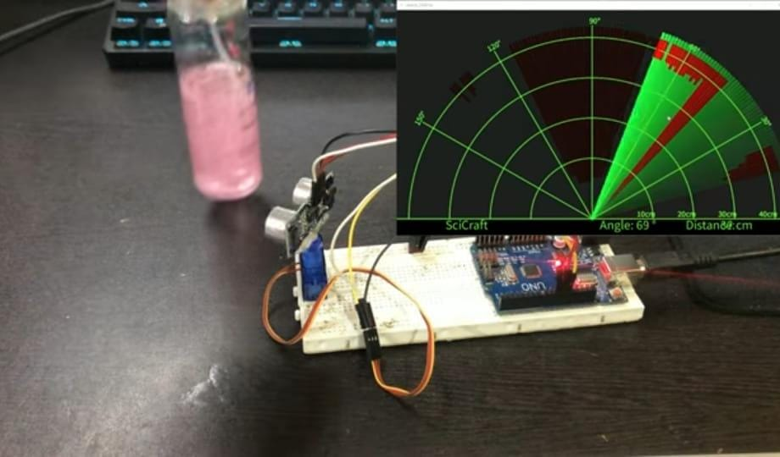
WORKING MODEL

Slide 10
WORKING MODEL EXPLANATION
The Arduino powers the ultrasonic sensor and servo motor.
The servo motor rotates the ultrasonic sensor from 0° to 180° to scan the area.
The ultrasonic sensor sends out sound waves and waits for them to bounce back from any object.
Arduino measures the time taken for the waves to return and calculates the distance of the object.

Slide 11
WORKING MODEL EXPLANATION
As the servo rotates, the sensor keeps checking for objects in different directions.
The distance and angle of the object are used to display the object’s position on a radar screen (in Processing software or serial monitor).
This process repeats continuously, creating a live radar-like scanning system that detects nearby objects.

Slide 12
CONCLUSION
The radar system effectively detects and measures the distance of nearby objects using an ultrasonic sensor and Arduino.
The servo motor enables the sensor to scan a wide area, providing a clear understanding of radar operation.
The project offers a low-cost, efficient, and educational model for learning object detection and automation principles.

Slide 13
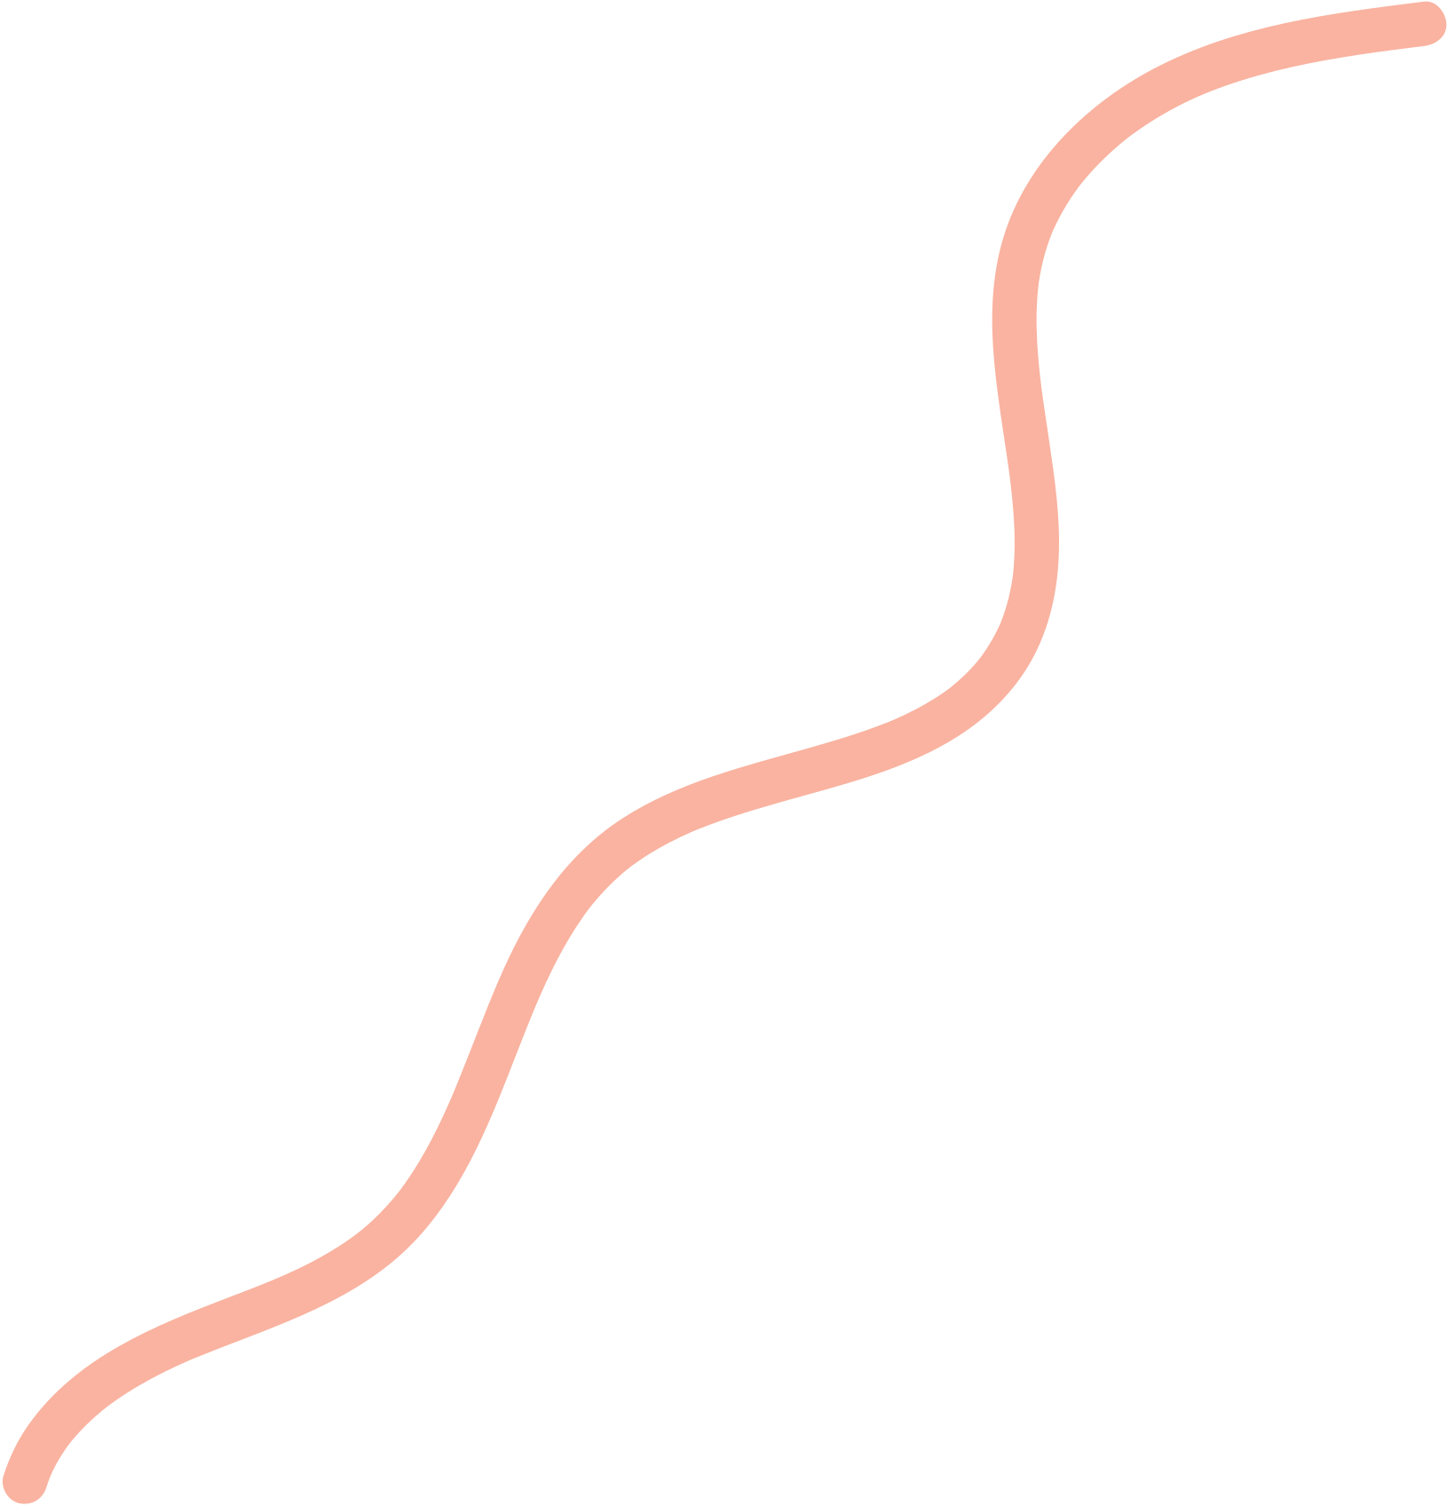

THANK
YOU

